Slide 1
Applied Machine Learning SEZG568/SSZG568
Dr Y V K RAVI KUMAR
yvk.ravikumar@pilani.bits-pilani.ac.in

Slide 2
Classification Models - 2
Topics
Navie Bayes Classifier
Logistic Regression
Linear Support Vector Machines
Non Linear Support Vector Machines
Comparative Analysis and Applicability

Slide 3
7 | Classification Models I: Support Vector Machine. Margin maximization. Non-linear SVM. Kernel Function. | T1: Chapter 5 T2: Chapter 5

Slide 4
A Simple Example
Which tag does the sentence A very close game belong to? i.e. P(sports| A very close game)
Text | Tag
“A great game” | Sports
“The election was over” | Not sports
“Very clean match” | Sports
“A clean but forgettable game” | Sports
“It was a close election” | Not sports
Feature Engineering: Bag of words i.e use word frequencies without considering order
Using Bayes Theorem:
P(sports| A very close game)
= P(A very close game| sports) P(sports)
----------------------------------------------
P(A very close game)
We assume that every word in a sentence is independent of the other ones
“close” doesn’t appear in sentences of sports tag, So P(close | sports) = 0, which makes product 0

Slide 5
Laplace smoothing
Laplace smoothing: we add 1 or in general constant k to every count so it’s never zero.
To balance this, we add the number of possible words to the divisor, so the division will never be greater than 1
In our case, the possible words are ['a', 'great', 'very', 'over', 'it', 'but', 'game', 'election', 'clean', 'close', 'the', 'was', 'forgettable', 'match'].

Slide 6
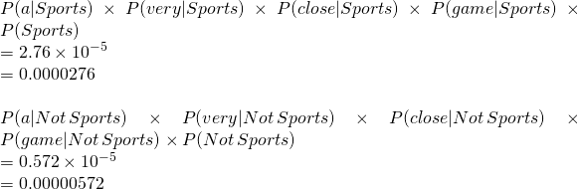
Apply Laplace Smoothing
Word | P(word | Sports) | P(word | Not Sports)
a | 2+1 / 11+14 | 1+1 / 9+14
very | 1+1 / 11+14 | 0+1 / 9+14
close | 0+1 / 11+14 | 1+1 / 9+14
game | 2+1 / 11+14 | 0+1 / 9+14

Slide 7
Example
Doc No | Text
1 | I LOVED THE MOVIE
2 | I HATED THE MOVIE
3 | A GREAT MOVIE ,GOOD MOVIE
4 | POOR ACTING
5 | GREAT ACTING , A GOOD MOVIE
NEW | I HATED THE POOR ACTING

Slide 8
Example
Doc No | Text
1 | I LOVED THE MOVIE _POSITIVE
2 | I HATED THE MOVIE _ NEGATIVE
3 | A GREAT MOVIE ,GOOD MOVIE _POSITIVE
4 | POOR ACTING _NEGATIVE
5 | GREAT ACTING , A GOOD MOVIE _POSITIVE
NEW | I HATED THE POOR ACTING _????

Slide 14
Logistic Regression

Slide 15
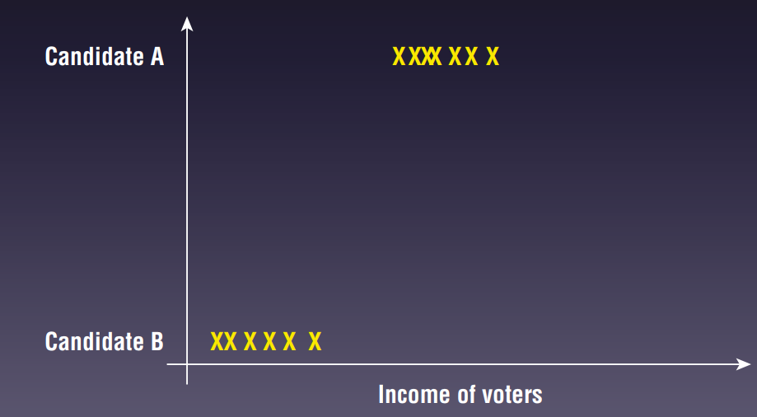
Logistic Regression
Classification Example
Consider the example shown in Fig.
Suppose that you have a dataset containing information about voter income and voting preferences.
For this dataset, you can see that low-income voters tend to vote for candidate B, while high-income voters tend to favor candidate A.
We would be very interested in trying to predict which candidate future voters will vote for based on their income level.

Slide 16
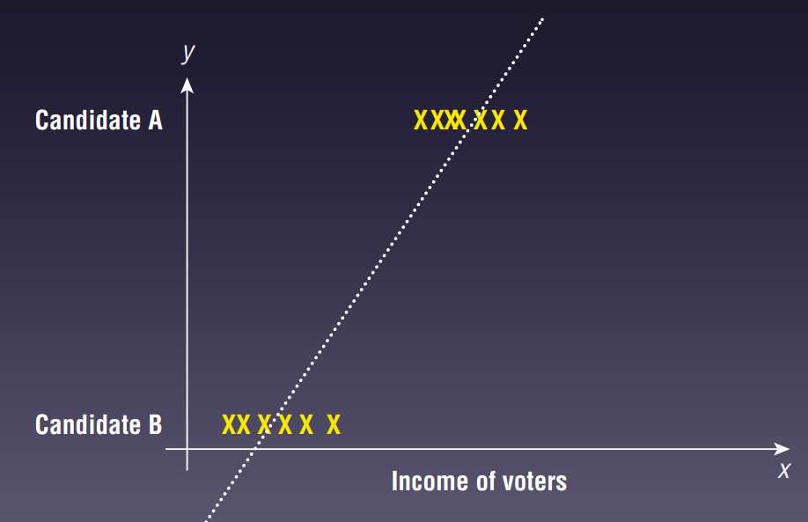
Logistic Regression
Classification Example
At first glance, we might be tempted to solve this problem using linear regression.
Fig shows what it looks like when you apply linear regression to this problem.
With linear regression, the predicted value does not always fall within the expected range.
Consider the case of a very low-income voter (near to 0)
We can see from the chart that the predicted result is a negative value.
We actually want the prediction as a value from 0 to 1 (which is the probability of an event happening.

Slide 17
Logistic Regression
Overview
Logistic Regression (also called Logit Regression)
Logistic Regression is commonly used to estimate the probability that an instance belongs to a particular class
E.g., what is the probability that this email is spam?
Estimate the probability
If greater than 50%,
then the model predicts that the instance belongs to that class (called the positive class, labeled “1”),
else
it predicts that it does not (i.e., it belongs to the negative class, labeled “0”).
This makes logistic regression a binary classifier.

Slide 18
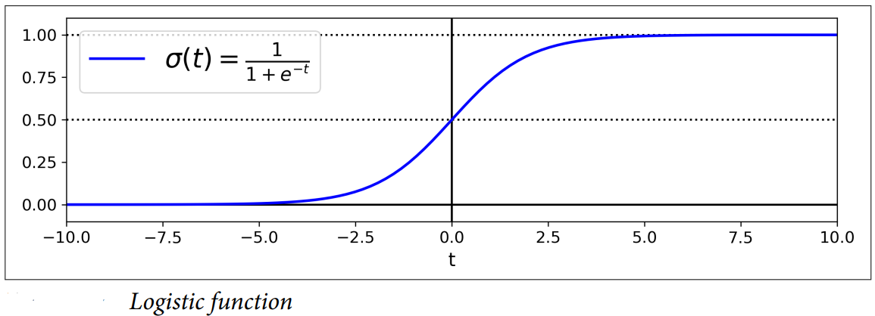
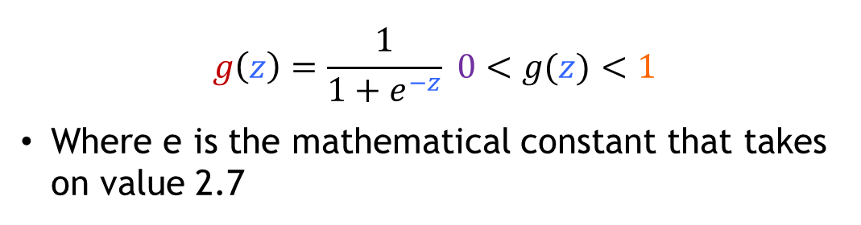
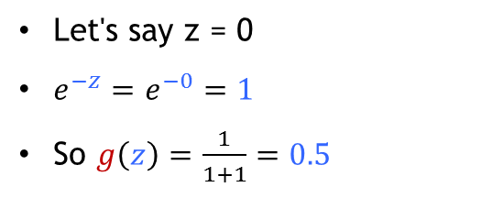
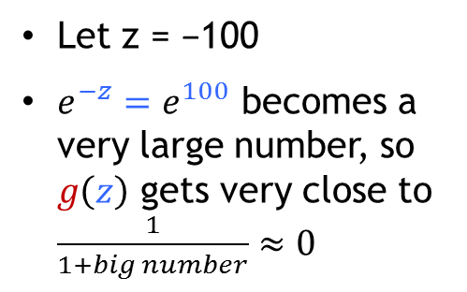
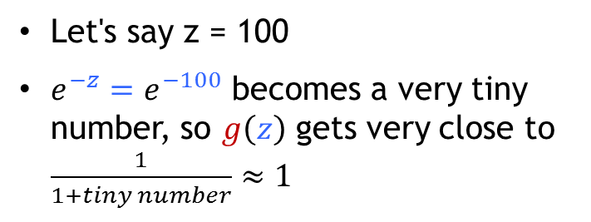
Logistic Regression
Sigmoid or Logistic Function
Let's say z = 100
$e^{−z}=e^{−100}$ becomes a very tiny number, so $g\left(z\right)$ gets very close to $\frac{1}{1+tiny number}≈1$
$$g\left(z\right)=\frac{1}{1+e^{−z}} 0<g(z)<1$$
Where e is the mathematical constant that takes on value 2.7
Let z = −100
$e^{−z}=e^{100}$ becomes a very large number, so $g\left(z\right)$ gets very close to $\frac{1}{1+big number}≈0$
Let's say z = 0
$e^{−z}=e^{−0}=1$
So $g\left(z\right)=\frac{1}{1+1}=0.5$

Slide 19
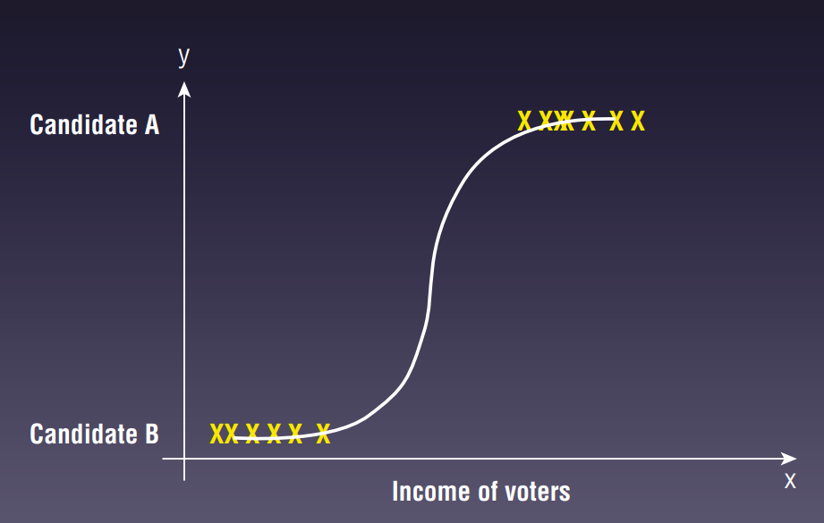
Logistic Regression
Applying Logistic Regression
Logistic regression can solve this problem.
Instead of using Linear Regression, we now use a curved line to try to fit all of the points on the chart.
Using logistic regression, the output will be a value from 0 to 1
Anything less than (or equal to) 0.5 (known as the threshold) will be considered as voting for candidate B, and anything greater than 0.5 will be considered as voting for candidate A.

Slide 20
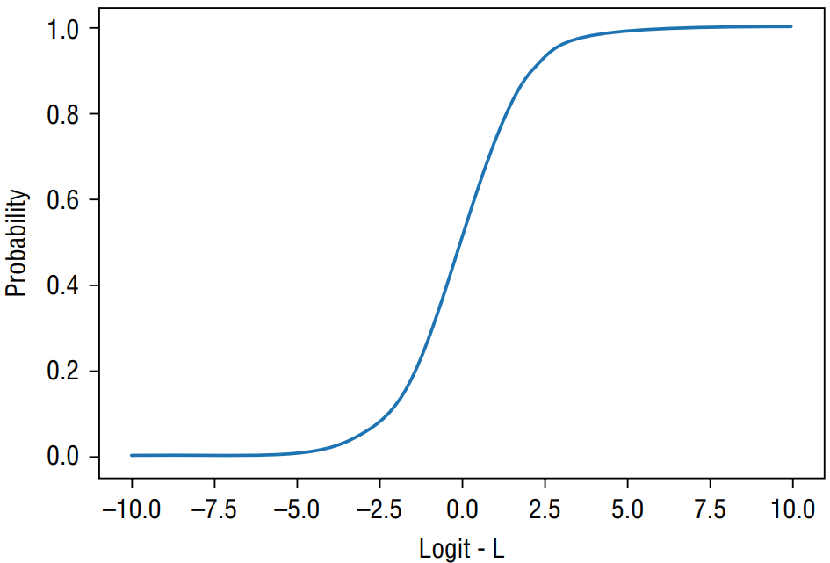
Logistic Regression
Plotting Sigmoid Curve
The following code snippet shows how the sigmoid curve is obtained:
def sigmoid(x):
return (1 / (1 + np.exp(-x)))
x = np.arange(-10, 10, 0.0001)
y = [sigmoid(n) for n in x]
plt.plot(x,y)
plt.xlabel("Logit - L")
plt.ylabel("Probability")
Fig shows the sigmoid curve.

Slide 21
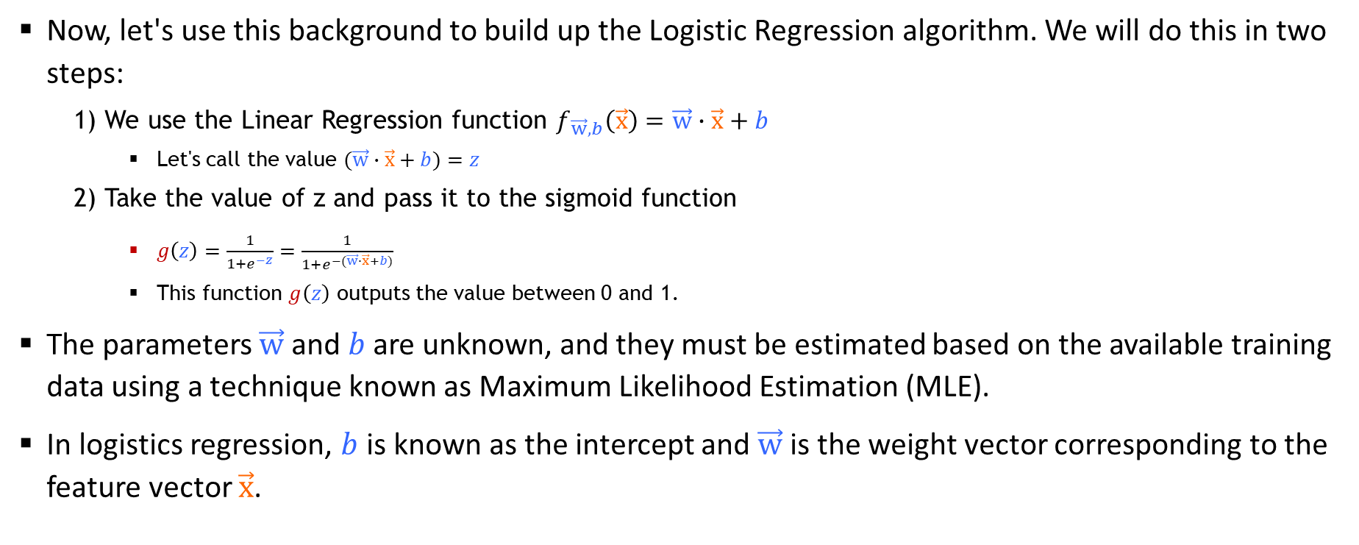
Logistic Regression
The Algorithm
Now, let's use this background to build up the Logistic Regression algorithm. We will do this in two steps:
1) We use the Linear Regression function $f_{\vec{w},b}\left(\vec{x}\right)=\vec{w}∙\vec{x}+b$
Let's call the value $(\vec{w}∙\vec{x}+b)=z$
2) Take the value of z and pass it to the sigmoid function
$g\left(z\right)=\frac{1}{1+e^{−z}}=\frac{1}{1+e^{−(\vec{w}∙\vec{x}+b)}}$
This function $g\left(z\right)$ outputs the value between 0 and 1.
The parameters $\vec{w}$ and $b$are unknown, and they must be estimated based on the available training data using a technique known as Maximum Likelihood Estimation (MLE).
In logistics regression, $b$ is known as the intercept and $\vec{w}$ is the weight vector corresponding to the feature vector $\vec{x}$.

Slide 22
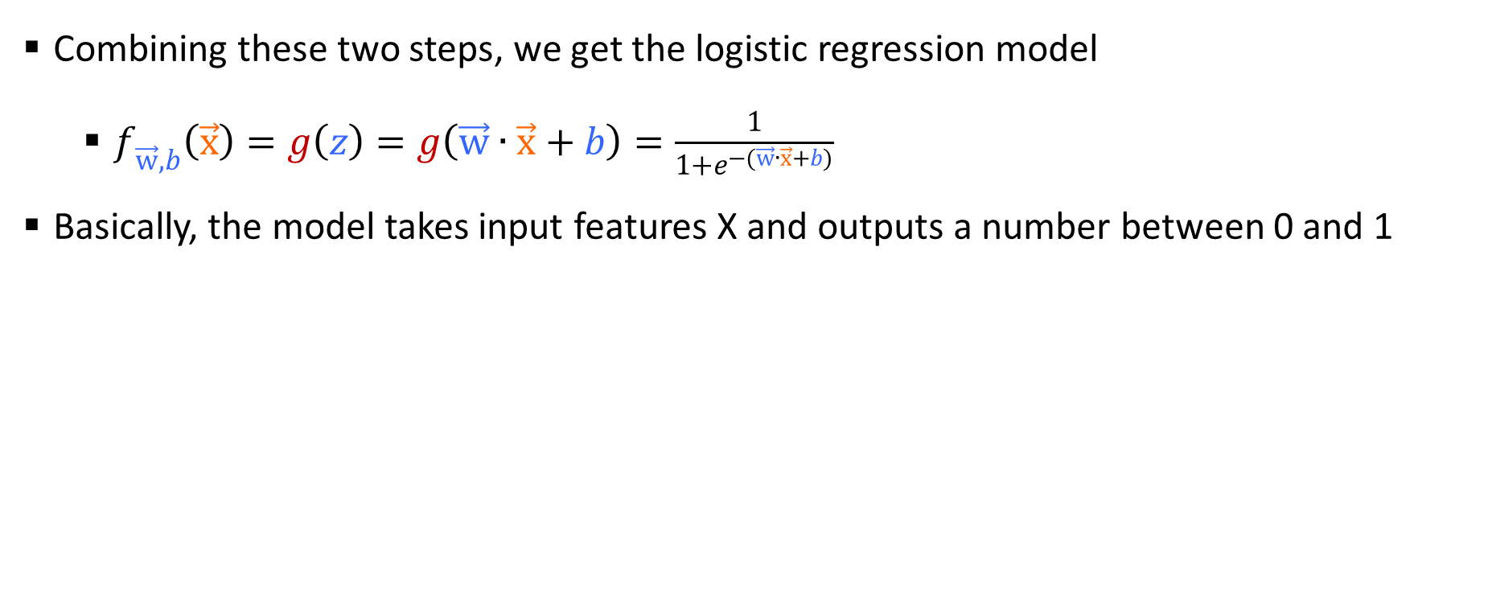
Logistic Regression
The Algorithm
Combining these two steps, we get the logistic regression model
$f_{\vec{w},b}\left(\vec{x}\right)=g\left(z\right)=g\left(\vec{w}∙\vec{x}+b\right)=\frac{1}{1+e^{−(\vec{w}∙\vec{x}+b)}}$
Basically, the model takes input features X and outputs a number between 0 and 1

Slide 23
Logistic Regression Application
Breast Cancer Dataset
Scikit-learn includes the Breast Cancer Wisconsin (Diagnostic) Data Set.
It is a popular dataset often used for illustrating binary classifications.
The dataset contains 569 samples and 30 features
These features are computed from a digitized image of a fine needle aspirate (FNA) of a breast mass.
The label (outcome) of the dataset is a binary classification—M for malignant or B for benign.
For more information:
https://archive.ics.uci.edu/ml/datasets/Breast+Cancer+Wisconsin+(Diagnostic)

Slide 24
Logistic Regression Application
Examining the Relationship Between Features
First, load the Breast Cancer dataset by first importing the datasets module from sklearn.
Then use the load _ breast _ cancer() function as follows:
from sklearn.datasets import load_breast_cancer
cancer = load_breast_cancer()

Slide 25
Logistic Regression Application
Plotting the Features in 2D
Let’s plot the first two features of the dataset in 2D and examine their relationships.
The following code snippet:
Loads the Breast Cancer dataset
Copies the first two features of the dataset into a two-dimensional list
Plots a scatter plot showing the distribution of points for the two features
Displays malignant growths in red and benign growths in blue

Slide 26
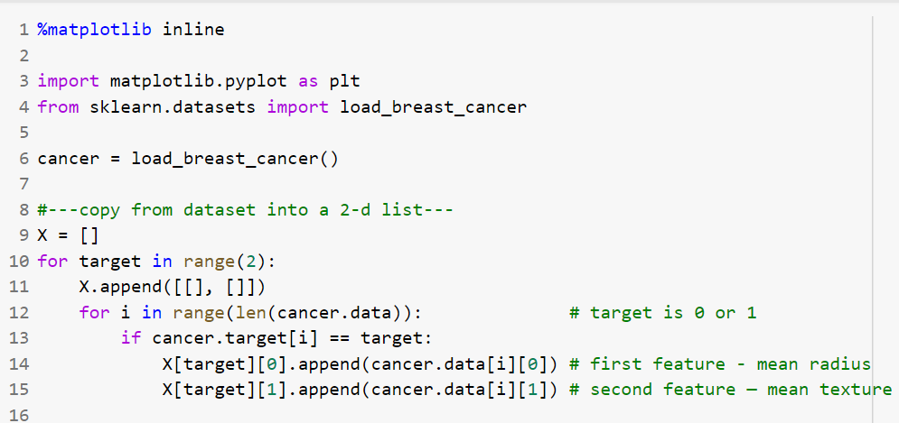
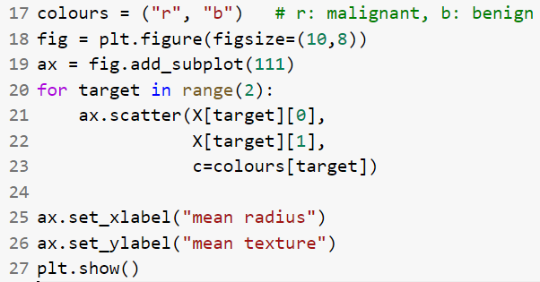
Logistic Regression Application
Plotting the Features in 2D

Slide 27
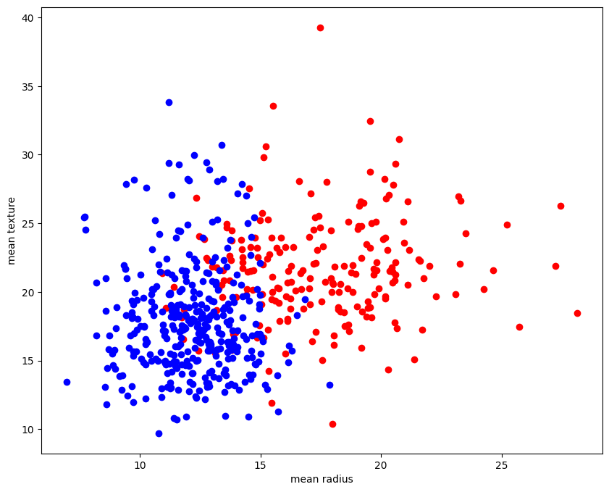
Logistic Regression Application
Plotting the Features in 2D

Slide 28
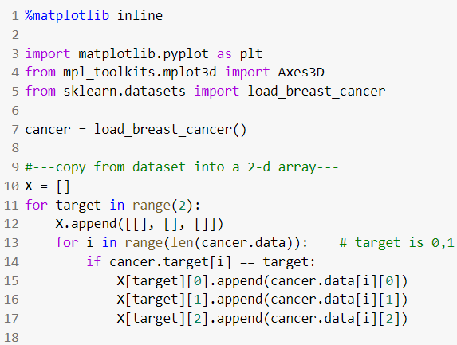
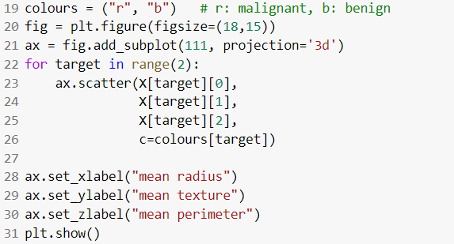
Logistic Regression Application
Plotting the Features in 3D
The following code snippet is very similar to the 2D code snippet, with the additional statements in bold:

Slide 29
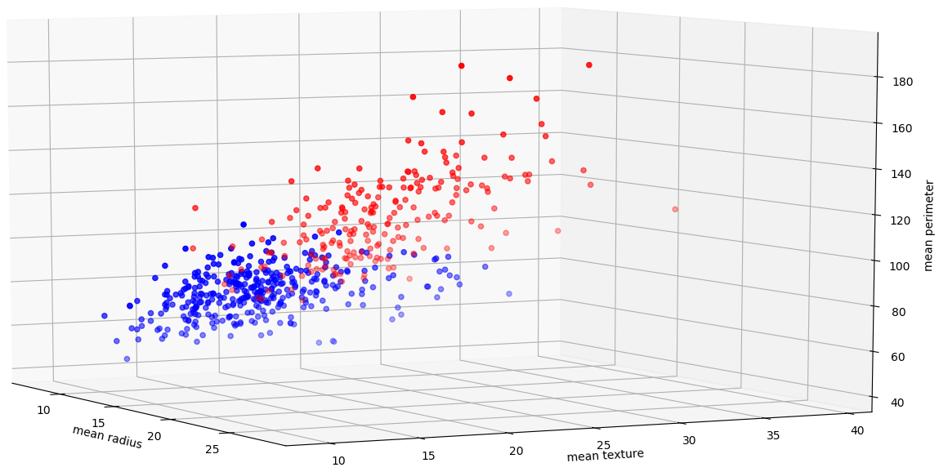
Logistic Regression Application
Plotting the Features in 3D

Slide 30
Logistic Regression Application
Features of the Dataset
Running the following command displays the list of features of this dataset.
>>>cancer.feature_names
>>>array(['mean radius', 'mean texture', 'mean perimeter', 'mean area', 'mean smoothness', 'mean compactness', 'mean concavity', 'mean concave points', 'mean symmetry', 'mean fractal dimension', 'radius error', 'texture error', 'perimeter error', 'area error', 'smoothness error', 'compactness error', 'concavity error', 'concave points error', 'symmetry error', 'fractal dimension error', 'worst radius', 'worst texture', 'worst perimeter', 'worst area', 'worst smoothness', 'worst compactness', 'worst concavity', 'worst concave points', 'worst symmetry', 'worst fractal dimension'], dtype='<U23')

Slide 31
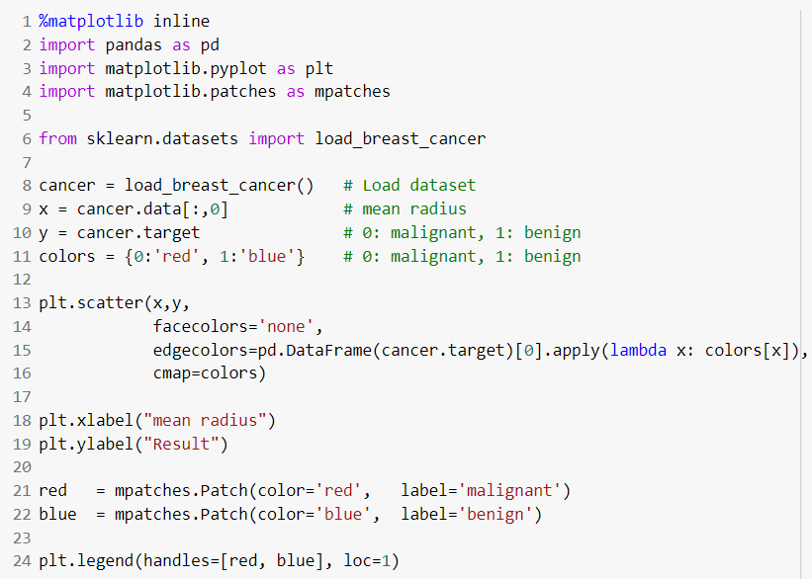
Logistic Regression Application
Training Using One Feature
Now, let’s use logistic regression to predict if a tumor is cancerous.
We will use only the first feature ('mean radius') of the dataset.
The code snippet plots a scatter plot showing if a tumor is malignant or benign based on the mean radius:

Slide 32
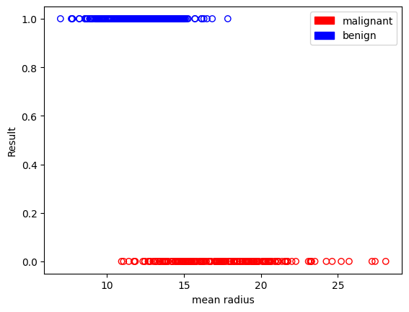
Logistic Regression Application
Training Using One Feature

Slide 33
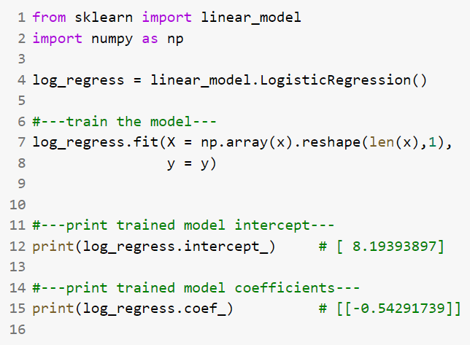
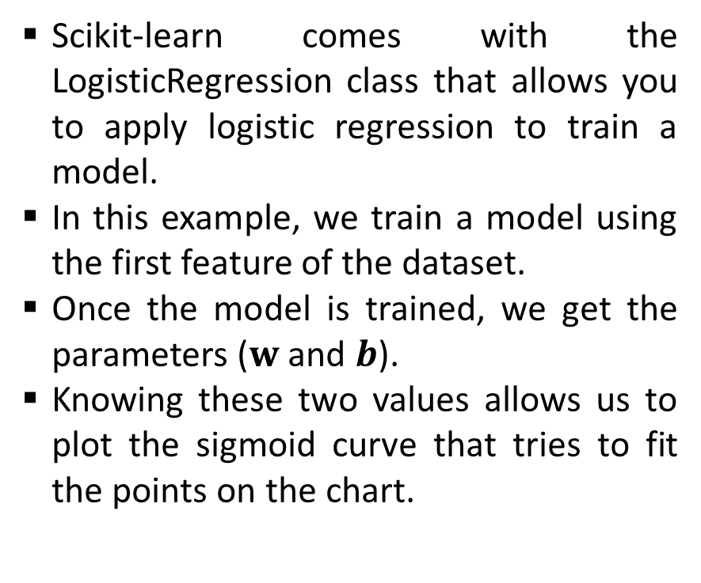
Logistic Regression Application
Finding the Parameters ($w$ and $b$)
Scikit-learn comes with the LogisticRegression class that allows you to apply logistic regression to train a model.
In this example, we train a model using the first feature of the dataset.
Once the model is trained, we get the parameters ($w$ and $b$).
Knowing these two values allows us to plot the sigmoid curve that tries to fit the points on the chart.

Slide 34
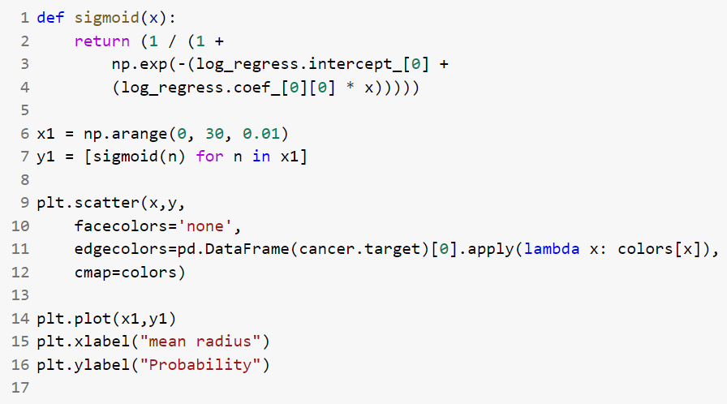
Logistic Regression Application
Plotting the Sigmoid Curve
With the values of w and b obtained, we can plot the sigmoid curve using the following code:

Slide 35
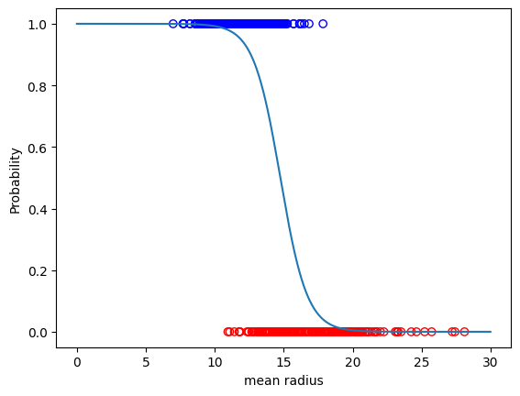
Logistic Regression Application
Plotting the Sigmoid Curve

Slide 36
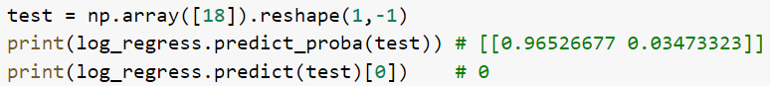
Logistic Regression Application
Making Predictions
Let’s try to predict the result if the mean radius is 18:
The predict_proba() function in the first statement returns a two-dimensional array.
The result of 0.96526677 indicates the probability that the prediction is 0 (malignant) while the result of 0.03473323 indicates the probability that the prediction is 1 (benign).
Based on the default threshold of 0.5, the prediction is that the tumor is malignant (value of 0), since its predicted probability (0.96526677) of 0 is more than 0.5.

Slide 37
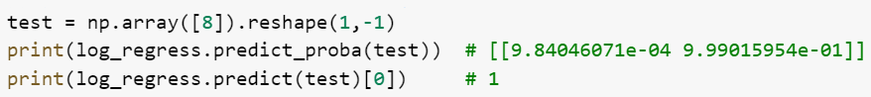
Logistic Regression Application
Making Predictions
The predict() function in the second statement returns the class that the result lies in (which in this case can be a 0 or 1).
The result of 0 indicates that the prediction is that the tumor is malignant.
Try another example with the mean radius of 15, 8, and 25 and observe the result.

Slide 38
Logistic Regression Application
Training the Model Using All Features
Let’s now try to train the model using all of the features and then see how well it can accurately perform the prediction.
First, load the dataset:
from sklearn.datasets import load_breast_cancer
cancer = load_breast_cancer() # Load dataset
Instead of training the model using all of the rows in the dataset, we are going to split it into two sets, one for training and one for testing, using train_test_split() function.
This function splits the data into training and test subsets randomly.
The following code snippet splits the dataset into a 75 percent training and 25 percent testing set:

Slide 39
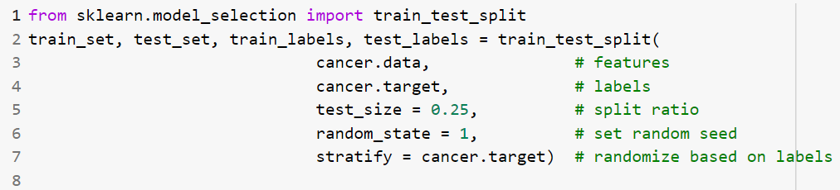
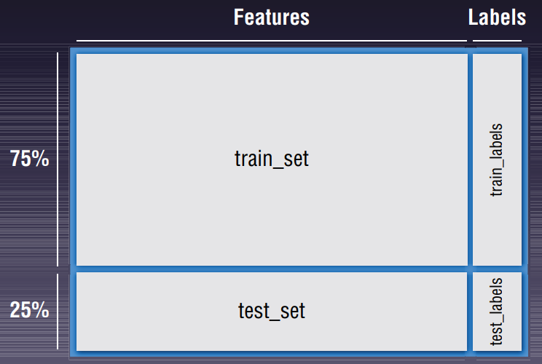
Logistic Regression Application
Training the Model Using All Features
Figure shows how the dataset is split.

Slide 40
Logistic Regression Application
Training the Model Using All Features
The random _ state parameter of the train _ test _ split() function specifies the seed used by the random number generator.
If this is not specified, every time you run this function you will get a different training and testing set.
The stratify parameter allows you to specify which column (feature/label) to use so that the split is proportionate.
For example, if the column specified is a categorical variable with 80 percent 0s and 20 percent 1s, then the training and test sets would each have 80 percent of 0s and 20 percent of 1s.

Slide 41
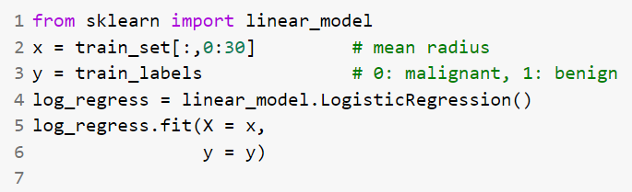
Logistic Regression Application
Training the Model Using All Features
Once the dataset is split, it is now time to train the model.
The following code snippet trains the model using logistic regression:

Slide 42
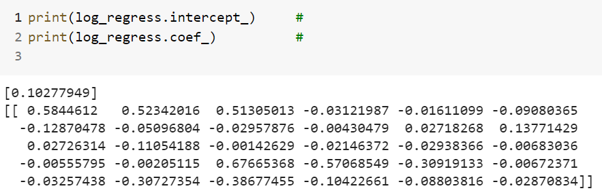
Logistic Regression Application
Training the Model Using All Features
In this example, we are training it with all of the 30 features in the dataset.
When the training is done, let’s print out the parameters b and w:
Because we have trained the model using 30 features, there are 30 coefficients.

Slide 43
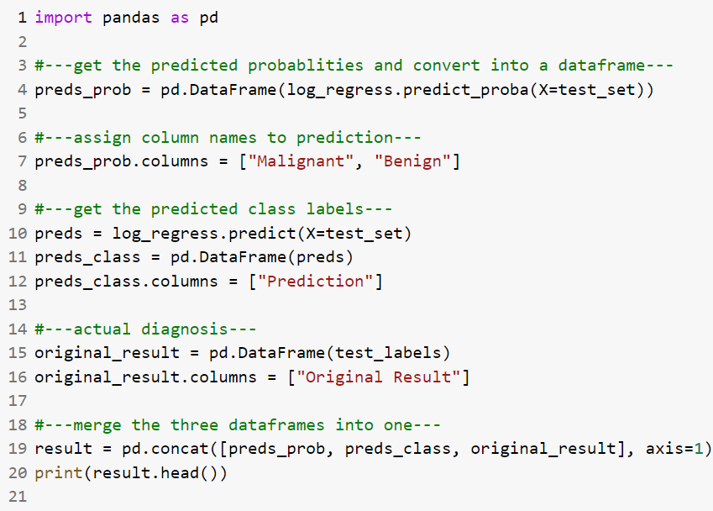
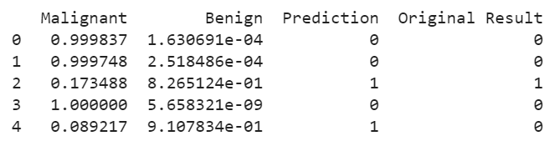
Logistic Regression Application
Testing the Model
The following code snippet uses the test set and feeds it into the model for making predictions.
The Output

Slide 44
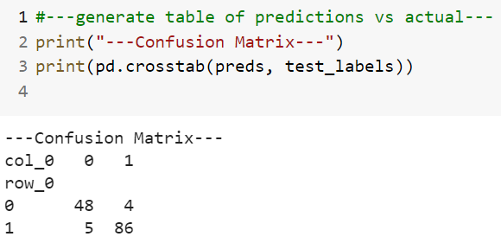
Logistic Regression Application
Getting the Confusion Matrix
To see how good the model is in predicting if a tumor is cancerous, we use confusion matrix.
The confusion matrix shows the number of actual and predicted labels and how many of them are classified correctly.
Pandas’s crosstab() function computes a simple cross-tabulation of two factors.

Slide 45
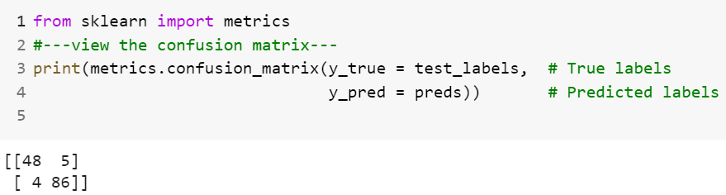
Logistic Regression Application
Getting the Confusion Matrix
In addition to using the crosstab() function, we can also use the confusion_matrix() function to print out the confusion matrix:

Slide 46
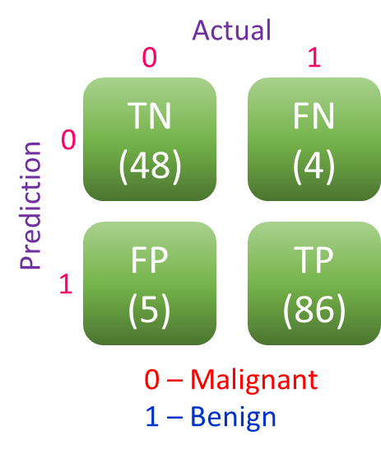
Logistic Regression Application
Getting the Confusion Matrix
The output is interpreted as shown below:
The columns represent the actual diagnosis (0 for malignant and 1 for benign).
The rows represent the prediction.
Each individual box represents one of the following:
True Negative (TN), True Positive (TP), False Negative (FN), False Positive (FP)

Slide 47
Logistic Regression Application
Getting the Confusion Matrix
True Positive (TP): The model correctly predicts the outcome as positive.
In this example, the number of TP (86) indicates the number of correct predictions that a tumor is benign.
True Negative (TN): The model correctly predicts the outcome as negative.
In this example, 48 tumors were correctly predicted to be malignant.
False Positive (FP): The model incorrectly predicted the outcome as positive, but the actual result is negative.
In this example, it means that the tumor is actually malignant, but the model predicted the tumor to be benign.
False Negative (FN): The model incorrectly predicted the outcome as negative, but the actual result is positive.
In this example, it means that the tumor is actually benign, but the model predicted the tumor to be malignant.

Slide 48
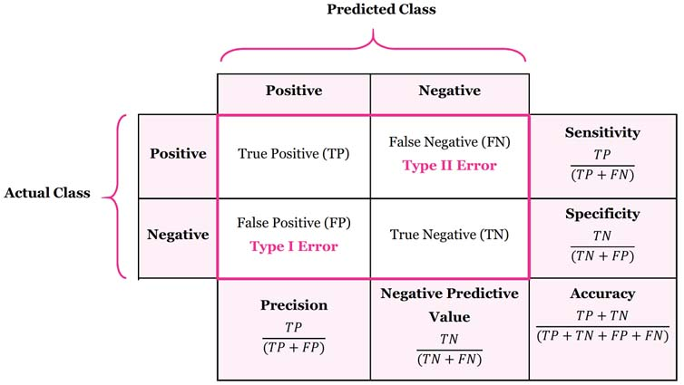
Logistic Regression Application
Computing Accuracy, Recall, Precision, and Other Metrics
Based on the confusion matrix, we can calculate the following metrics:
Accuracy
Precision
Recall (True Positive Rate)
F1 Score
False Positive Rate
Image: https://manisha-sirsat.blogspot.com/2019/04/confusion-matrix.html

Slide 49
Logistic Regression Application
Computing Accuracy, Recall, Precision, and Other Metrics
To understand the concept of precision and recall, consider the following scenario
If a malignant tumor is represented as negative and a benign tumor is represented as positive, then:
If the precision or recall is high, it means that more patients with benign tumors are diagnosed correctly, which indicates that the algorithm is good.
If the precision is low, it means that more patients with malignant tumors are diagnosed as benign.
If the recall is low, it means that more patients with benign tumors are diagnosed as malignant.

Slide 50
Logistic Regression Application
Computing Accuracy, Recall, Precision, and Other Metrics
Having a low precision is more serious than a low recall (although wrongfully diagnosed as having breast cancer when you do not have it will likely result in unnecessary treatment and mental anguish) because it causes the patient to miss treatment and potentially causes death.
Hence, for cases like diagnosing breast cancer, it’s important to consider both the precision and recall metrics when evaluating the effectiveness of an ML algorithm.

Slide 51
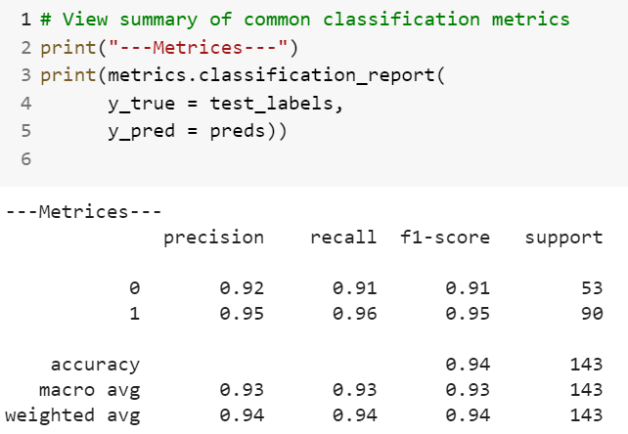
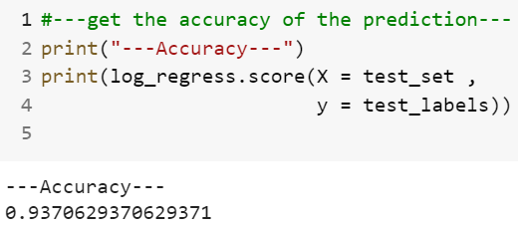
Logistic Regression Application
Computing Accuracy, Recall, Precision, and Other Metrics
To get the accuracy of the model, we can use the score() function of the model:
To get the precision, recall, and F1-score of the model, use the classification_report() function of the metrics module:

Slide 52
Logistic Regression Application
Receiver Operating Characteristic (ROC) Curve
An easy way to examine the effectiveness of an algorithm is to plot a curve known as ROC curve.
The ROC curve is created by plotting the TPR against the FPR at various threshold settings.
Scikit-learn has the roc_curve() function, which will calculate the FPR and TPR automatically based on the test labels and predicted probabilities:

Slide 53
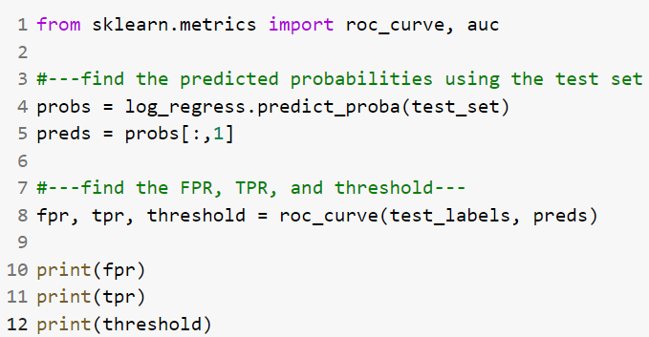
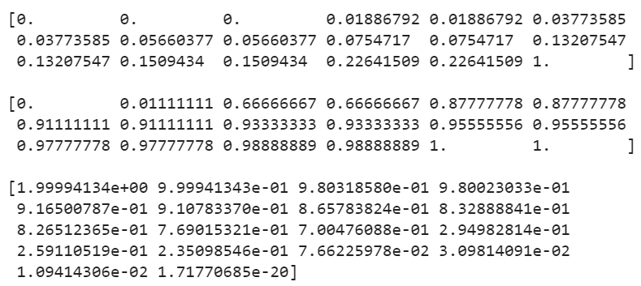
Logistic Regression Application
Receiver Operating Characteristic (ROC) Curve
The Output
As you can see from the output, the threshold starts at 1.99994134e⁺⁰⁰ and goes down to 1.71770685e⁻²⁰

Slide 54
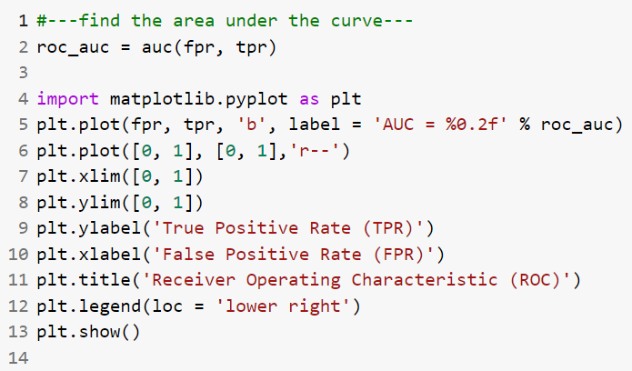
Logistic Regression Application
Plotting the ROC and Finding the Area Under the Curve (AUC)
To plot the ROC, we use matplotlib to plot a line chart using the values stored in the fpr and tpr variables.
We can use the auc() function to find the area under the ROC:

Slide 55
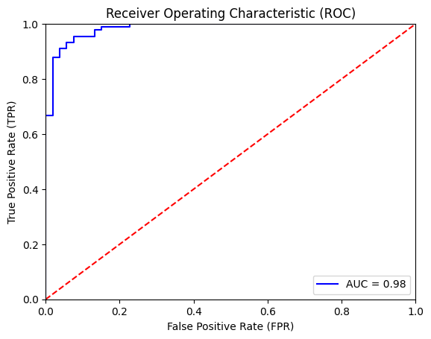
Logistic Regression Application
Plotting the ROC and Finding the Area Under the Curve (AUC)
The area under an ROC curve is a measure of the usefulness of a test in general
A greater area means a more useful test
The areas under ROC curves are used to compare the usefulness of tests.
Generally, aim for the algorithm with the highest AUC.

Slide 56
Support Vector Machine

Slide 57
Support Vector Machines
Find a linear hyperplane (decision boundary) that will separate the data

Slide 58
Support Vector Machines
One Possible Solution

Slide 59
Support Vector Machines
Another possible solution

Slide 60
Support Vector Machines
Other possible solutions

Slide 61
Support Vector Machines
Which one is better? B1 or B2?
How do you define better?

Slide 62
Support Vector Machines
Find hyperplane maximizes the margin
=> B1 is better than B2

Slide 63
Support Vector Machines

Slide 64
Linear SVM
Linear Model
Learning the model is equivalent to determining the values of
How to find from training data?

Slide 65
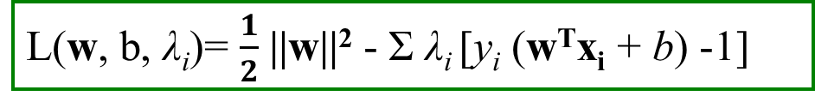
Learning Linear SVM
$$y_{i}(w•x_{i}+b)≥1, i=1,2,...,N$$
Objective is to maximize:
Which is equivalent to minimizing:
Subject to the following constraints:
or
This is a constrained optimization problem
Solve it using Lagrange multiplier method
Lagrange multipliers λ_{i} are 0 or +ve
L(w, b, λ_{i})= $\frac{1}{2}$ ||w||² - Σ λ_{i} [y_{i} (w^{T}x_{i} + b) -1]

Slide 66
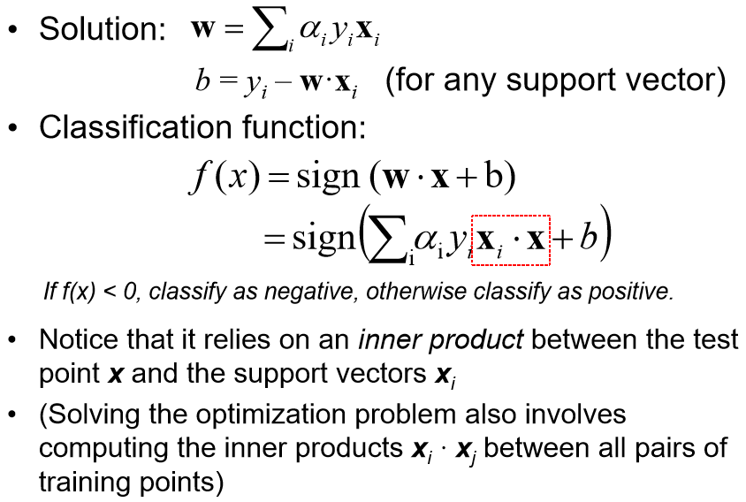
Learning Linear SVM
λ _{i}
λ_{i} is non-zero except for support vectors
λ _{i}

Slide 67
Example of Linear SVM
Support vectors

Slide 68
Learning Linear SVM
Decision boundary depends only on support vectors
If you have data set with same support vectors, decision boundary will not change
How to classify using SVM once w and b are found? Given a test record, x_{i}

Slide 69
Support Vector Machines
What if the problem is not linearly separable?

Slide 70
Support Vector Machines
What if the problem is not linearly separable?
Introduce slack variables
Need to minimize
subject to
If k is 1 or 2, this leads to similar objective function as linear SVM but with different constraints

Slide 71
Support Vector Machines
Find the hyperplane that optimizes both factors

Slide 72
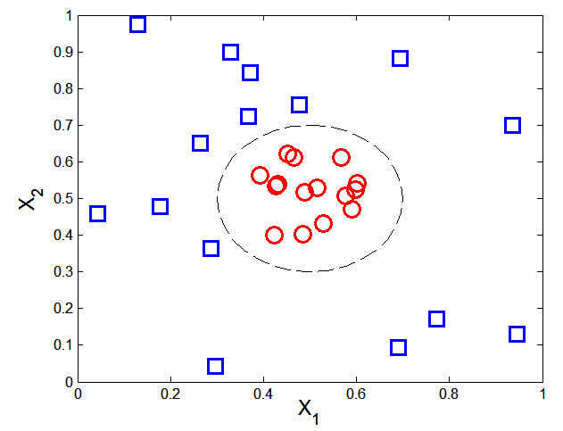
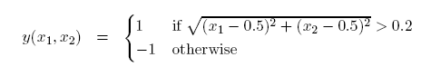
Nonlinear Support Vector Machines
What if decision boundary is not linear?

Slide 73
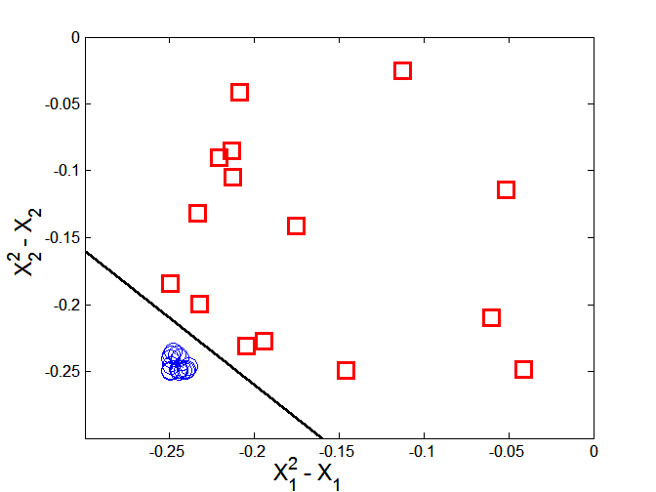
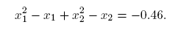
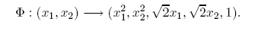
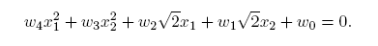
Nonlinear Support Vector Machines
Transform data into higher dimensional space
Decision boundary:

Slide 74




Learning Nonlinear SVM
Optimization Problem
which leads to the same set of equations (but involve Φ(x) instead of x)

Slide 75
Learning NonLinear SVM
Issues
What type of mapping function Φ should be used?
How to do the computation in high dimensional space?
Most computations involve dot product Φ(x_{i})• Φ(x_{j})
Curse of dimensionality?

Slide 76

Learning Nonlinear SVM
Kernel Trick:
Φ(x_{i})• Φ(x_{j}) = K(x_{i}, x_{j})
K(x_{i}, x_{j}) is a kernel function (expressed in terms of the coordinates in the original space)
Examples:

Slide 77

Example of Nonlinear SVM
SVM with polynomial degree 2 kernel

Slide 78
Learning Nonlinear SVM
Advantages of using kernel:
Don’t have to know the mapping function Φ
Computing dot product Φ(x_{i})• Φ(x_{j}) in the original space avoids curse of dimensionality
Not all functions can be kernels
Must make sure there is a corresponding Φ in some high-dimensional space
Mercer’s theorem (see textbook)

Slide 79
Summary
Robust to isolated noise points
Handle missing values by ignoring the instance during probability estimate calculations
Robust to irrelevant attributes
Redundant and correlated attributes will violate class conditional assumption

Slide 80
Thank You!

